Slide 1
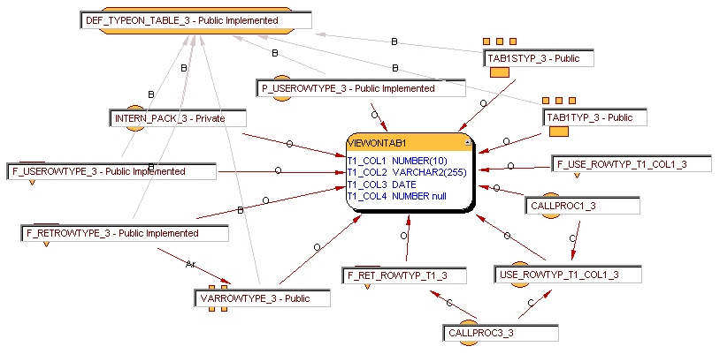
VIEWONTAB1

Slide 2
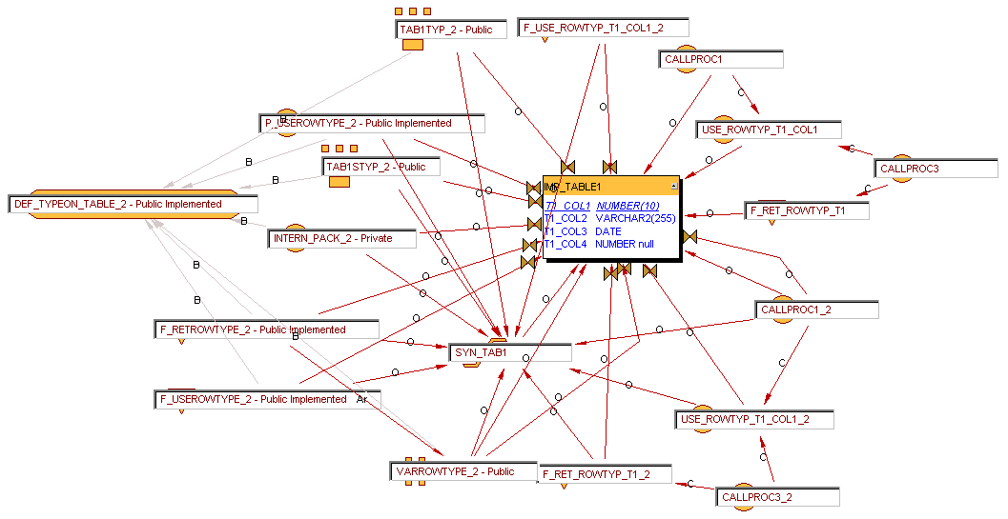
IMP_TABLE1 : ROWTYPE, 1

Slide 3
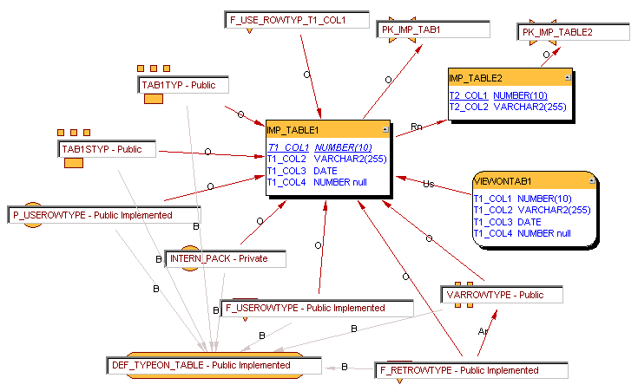
IMP_TABLE1 : ROWTYPE, 2

Slide 4
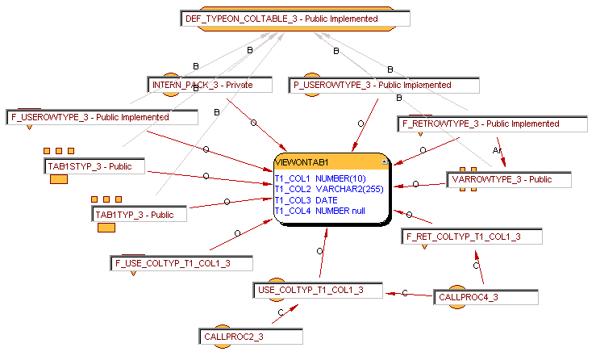
IMP_TABLE1 : TYPE, 1

Slide 5
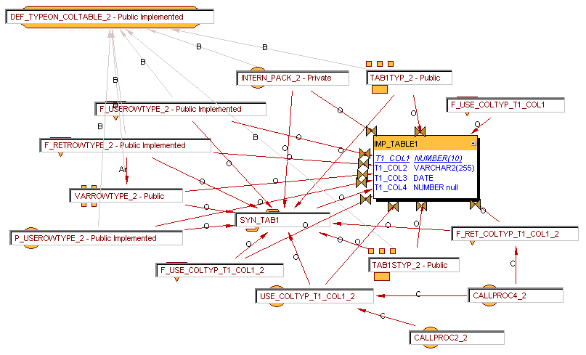
IMP_TABLE1 : TYPE, 2

Slide 6
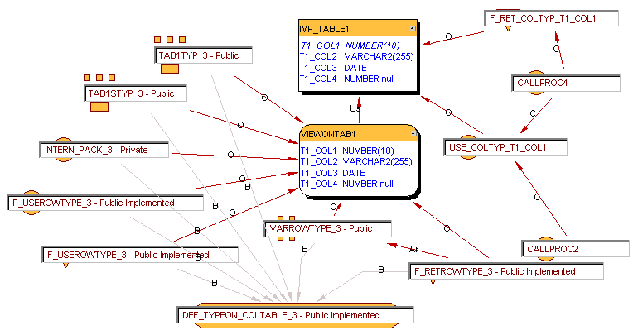
IMP_TABLE1 : TYPE, 3

Slide 7
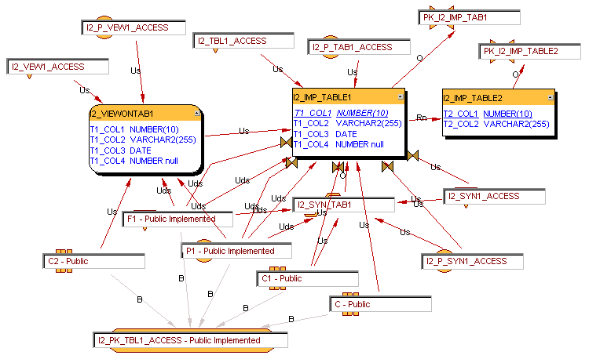
IMPACT2

Slide 8
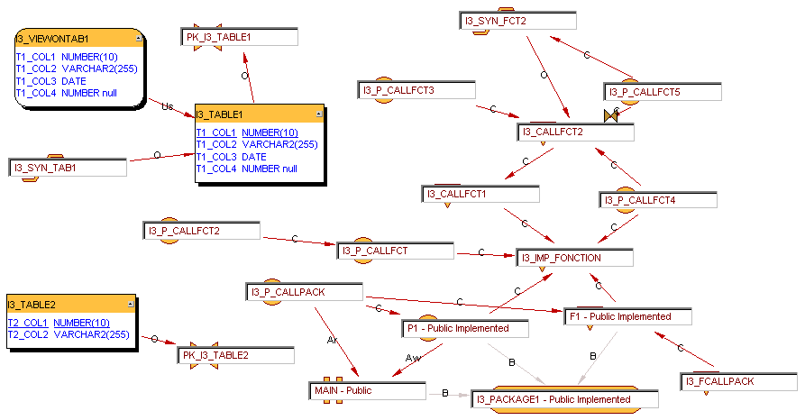
IMPACT3

Slide 9
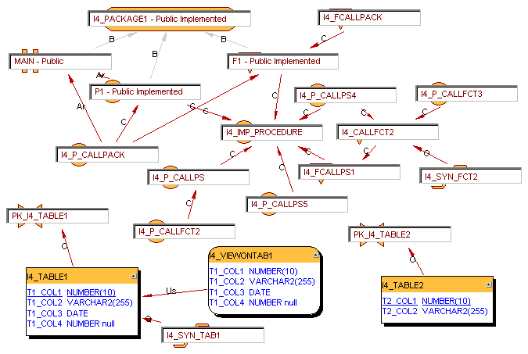
IMPACT4

Slide 10
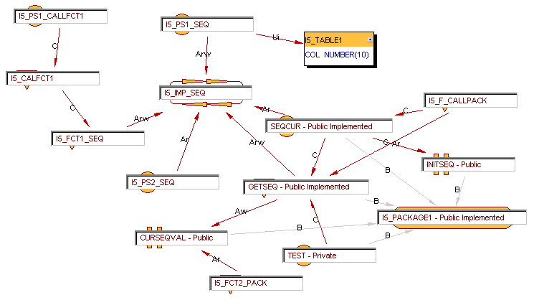
IMPACT5

Slide 11
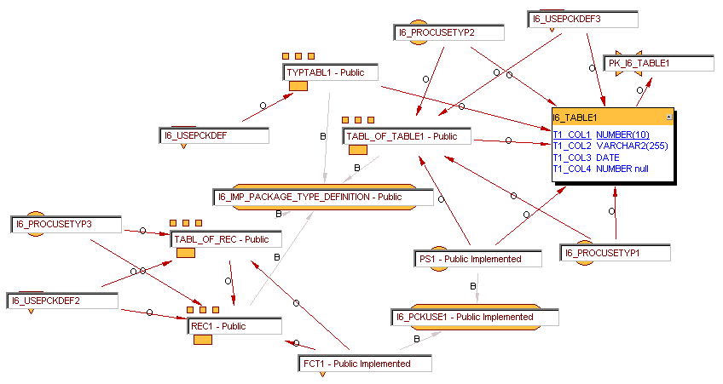
IMPACT6

Slide 12
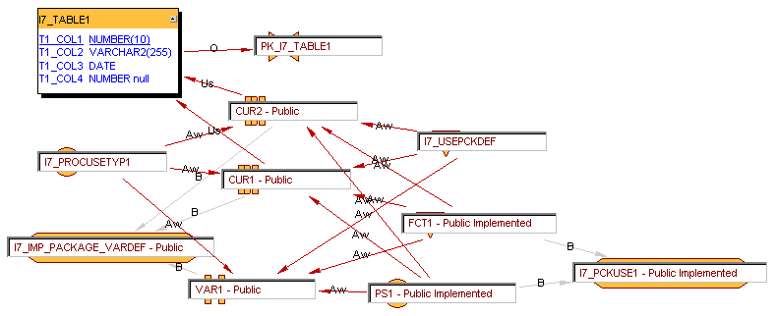
IMPACT7

Slide 13
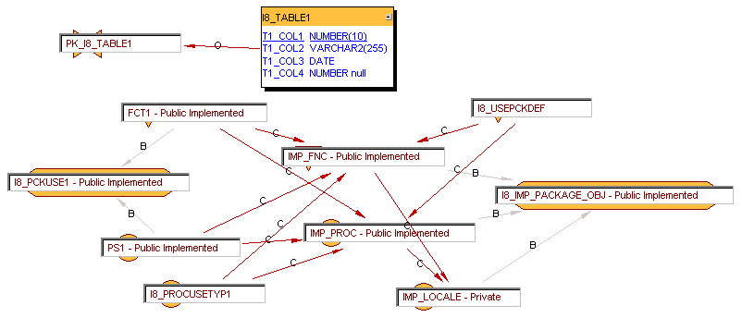
IMPACT8

Slide 14
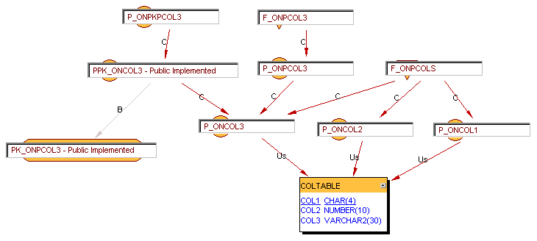
COLTABLE by PROCEDURES

Slide 15
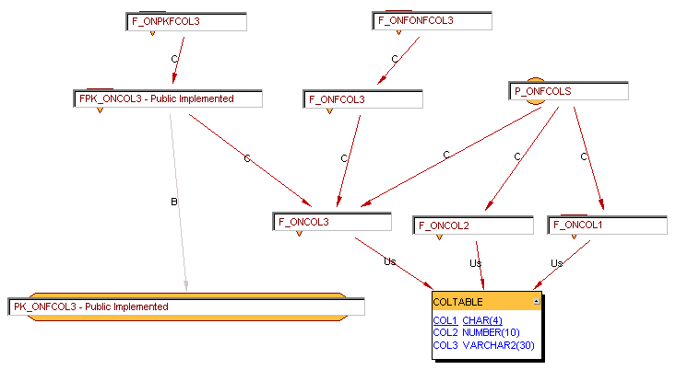
COLTABLE by FUNCTIONS

Slide 16
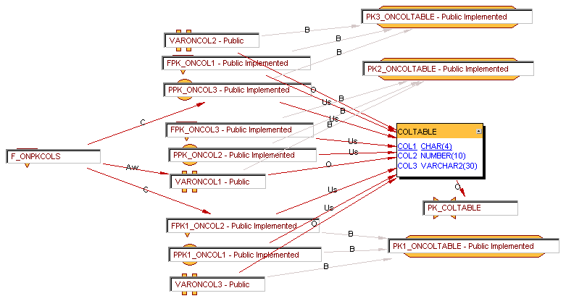
COLTABLE by PACKAGES

Slide 17
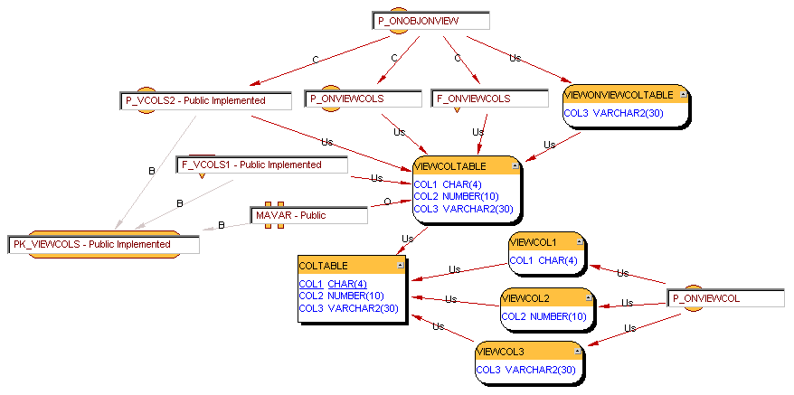
COLTABLE by VIEWS

